Slide 1
Elasticities, Margins and Profitability
Pricing Strategies
2025
Jean-Pierre Dubé
© Copyright 2025

Slide 2

Overview
Last lecture:
Optimal pricing requires knowledge of demand
Shape of demand determines pricing
Trade-off: sales volume vs margin
We used EVC as coarse approximation of demand
This lecture:
With better data, can use a smooth model of demand
Measure the price elasticity of demand
Use price elasticity to set optimal uniform price
optimal uniform price as GROWTH!!!

Slide 3
Recall: EVC was used to approximate the Demand Curve
True Demand
EVC approximation of Demand (module 1)
If use smooth approx. of demand, can feed demand estimates through an optimization algorithm to determine optimal uniform price

Slide 4

Field Data and Regression Example: Demand for 64 oz Roundy's OJ
Vol=104
Regression estimate of demand
(see Data-Driven Marketing course & extra slides)
Shelf Price of $2

Slide 5
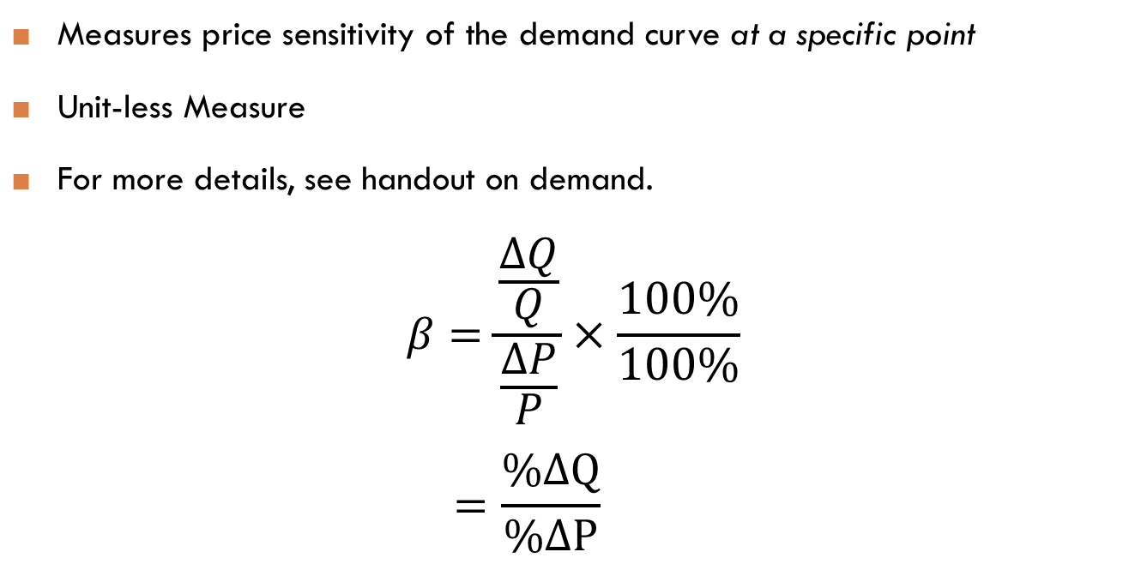
Review of price elasticity of demand
Measures price sensitivity of the demand curve at a specific point
Unit-less Measure
For more details, see handout on demand.
$$β=\frac{\frac{ΔQ}{Q}}{\frac{ΔP}{P}}×\frac{100\%}{100\%}$$
$$=\frac{\%ΔQ}{\%ΔP}$$
See Appendix for discussion of typical magnitudes of estimated elasticities in practice

Slide 6
Demand Elasticity at Pick N’ Save Example: 64 Oz Roundy's Orange Juice
Regression analysis of demand data gives us:
β = -3.11
a 1% price cut generates a 3.1% volume increase
(Loosely, average elasticity in range of data)
➔

Slide 7
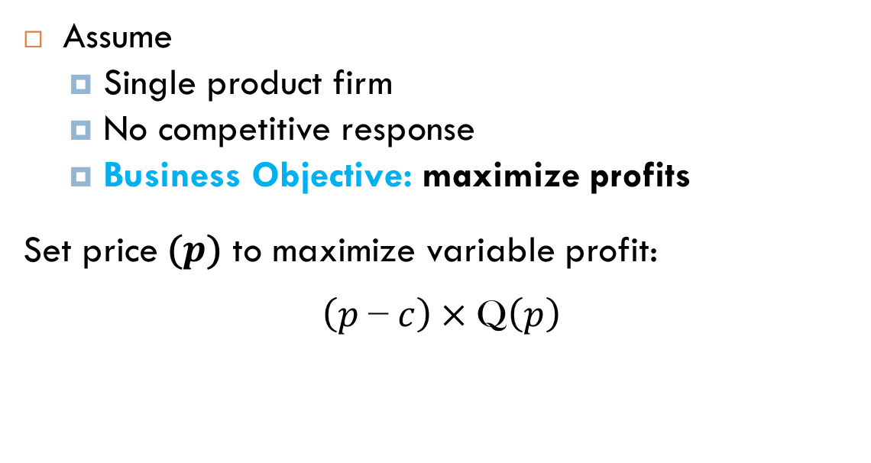
Monopoly price and elasticity The Profit-Maximizing Uniform Price
Assume
Single product firm
No competitive response
Business Objective: maximize profits
Set price$\text{(}p\text{)}$ to maximize variable profit:
$$\left(p \text{−} c\right)×\text{Q}\left(p\right)$$
Unlike last lecture, now assume Q(P) {i.e., demand} is smooth and differentiable so that we can compute elasticity
See Appendix for the margin arithmetic and break-even pricing when demand unknown

Slide 8
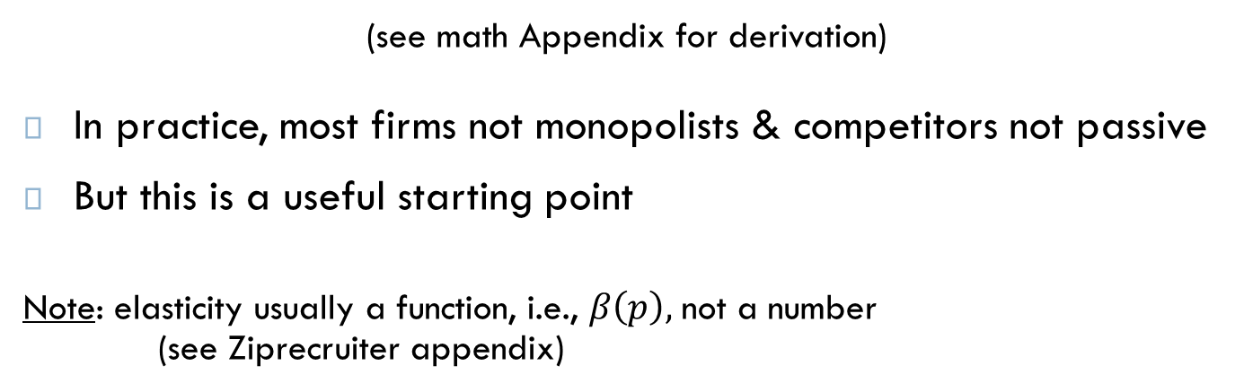
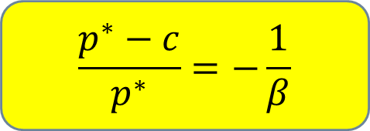
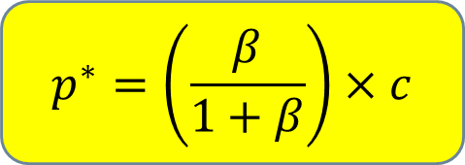
Monopoly price and elasticity The inverse-elasticity rule
Optimal Price is set such that:
inverse-elasticity rule
$$p^{∗}=\left(\frac{β}{1+β}\right)×c$$
$$\frac{p^{∗}−c}{p^{∗}}=−\frac{1}{β}$$
OR
(see math Appendix for derivation)
In practice, most firms not monopolists & competitors not passive
But this is a useful starting point
Note: elasticity usually a function, i.e., $β\left(p\right),$not a number
(see Ziprecruiter appendix)

Slide 9
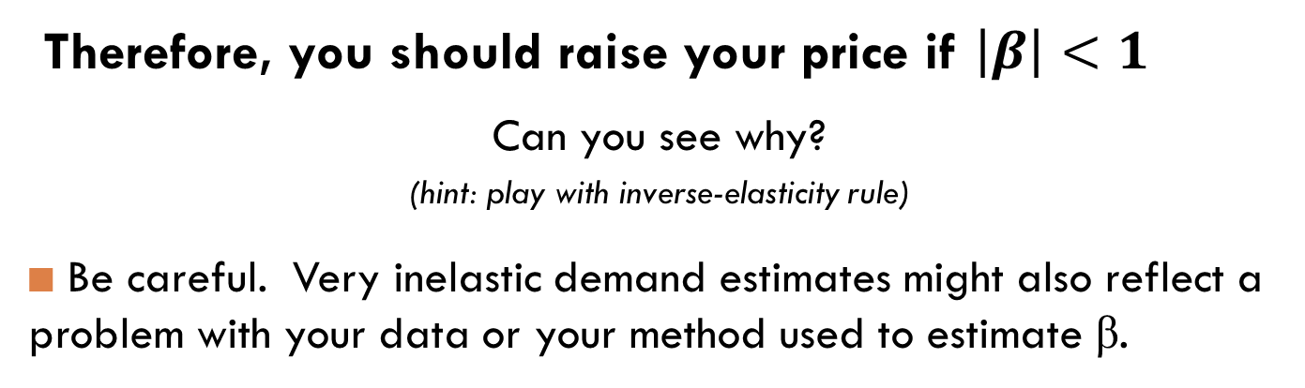

Pricing on the elastic region of demand
Claim: if a firm maximizes its (current) profits, then
$$\left|β\right|≥1$$
Therefore, you should raise your price if $\left|β\right|<1$
Can you see why?
(hint: play with inverse-elasticity rule)
Be careful. Very inelastic demand estimates might also reflect a problem with your data or your method used to estimate β.

Slide 10
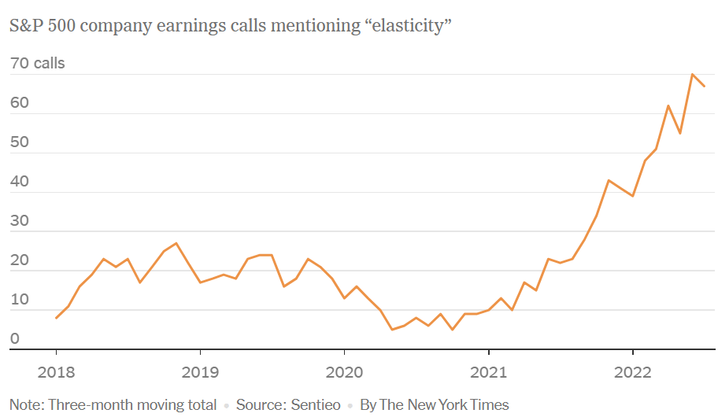
Pricing with the elasticity in practice
With inflationary pressures, companies are increasingly relying on the elasticity to justify their pricing to stakeholders
Source: “Why Are C.E.O.s Suddenly Obsessed With ‘Elasticity’?” By Jason Karaian and Veronica Majerol, WSJ, 08/19/2022

Slide 11
Demand regressions at Pick N’ Save Example: Refrigerated Orange Juice
Current price $2.00
Current price $2.99

Slide 12
Optimal Prices at Pick N’ Save Example: Refrigerated Orange Juice
Let’s design a pricing dashboard for refrigerated orange juice
The dashboard is designed to help with decision-making
The dashboard will consist of:
metrics
visualizations

Slide 13



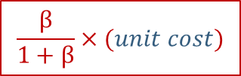
A Pricing Dashboard for Pick N’ Save Example: Refrigerated Orange Juice
 | Own-Elasticity
Roundy's 64 Oz | -3.11
Minute Maid 64 Oz | -2.40
Optimal Margin
32%
42%
Optimal Mark-up
47.39%
71.6%
Optimal Price
$2.46
$3.53
$$β$$
$$−\frac{1}{β}$$
$\left(\frac{β}{1+β}−1\right)$ $×$100
Wholesale prices
Minute Maid 64 Oz = $2.06
Roundy’s 64 Oz = $1.67
$$\frac{β}{1+β}×(unit cost)$$
Note: we are ignoring cannibalization! We will consider product line pricing issues later in course.

Slide 14
Profitability Visualization Example: Refrigerated Orange Juice
$$π \left(p\right)=\left(p−2.06\right)×\hat{Q\left(p\right)}$$
GROWTH
$2.99
Profit-maximizing Price=$3.53

Slide 15
Measuring the Price Elasticity Field Experiments
A simple field experiment can be used to measure the own-price elasticity
Randomly assign prices to subjects into treatment and control conditions
e.g., subjects could be customers, stores, cities etc.
You will need to test multiple price points to learn demand
e.g., A/B/C testing

Slide 16

Pricing at Ziprecruiter

Slide 17


Pricing at Ziprecruiter.com
17
Academic collaboration with Ziprecruiter.com
Fastest growing HR company: 75,000 employers per month
Online matching platform for recruiters and applicants
High conversion rates and high quality matches
August 2015: charging $99 per month to “starter” businesses
… but why $99?
Source: Dubé and Misra (2023)
Notes:
Is there a $99 Cliff????

Slide 18
A Price Experiment at Ziprecruiter.com
18
How do you evaluate the $99 price?
How do you measure demand for a B2B digital service?
Note: marginal cost is $0
method:
We ran a B2B price experiment to measure demand and determine the optimal price at Ziprecruiter…
Source: Dubé and Misra (2023)

Slide 19
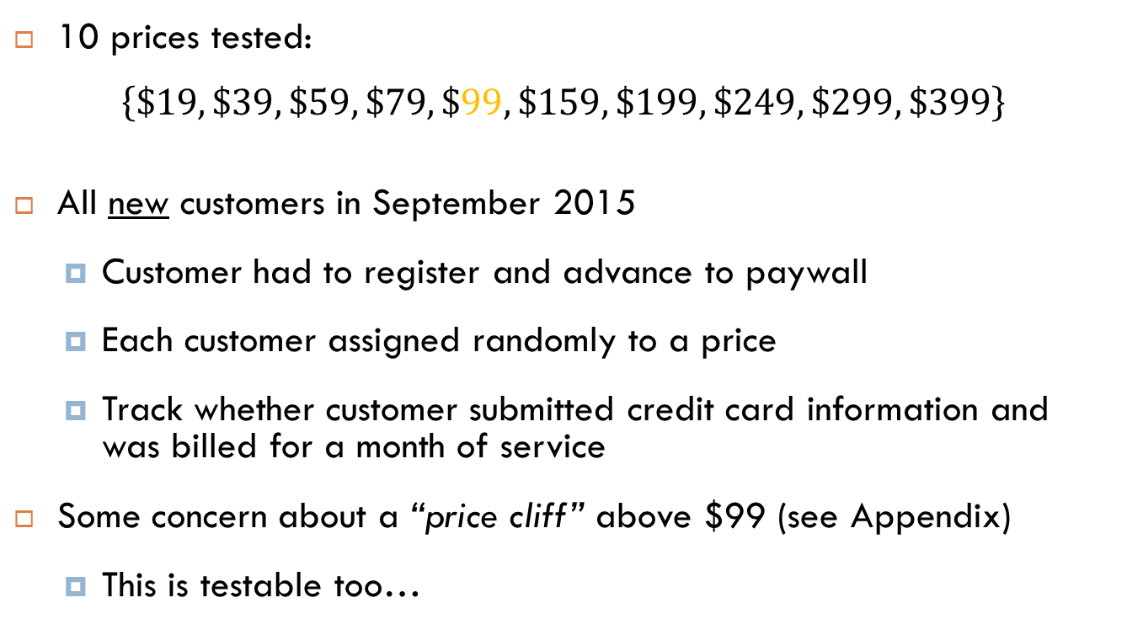
The Ziprecruiter Price Experiment Method
10 prices tested:
$$\left\{\$19, \$39, \$59, \$79, \$99, \$159, \$199, \$249, \$299, \$399\right\}$$
All new customers in September 2015
Customer had to register and advance to paywall
Each customer assigned randomly to a price
Track whether customer submitted credit card information and was billed for a month of service
Some concern about a “price cliff” above $99 (see Appendix)
This is testable too…
Source: Dubé and Misra (2023)

Slide 20
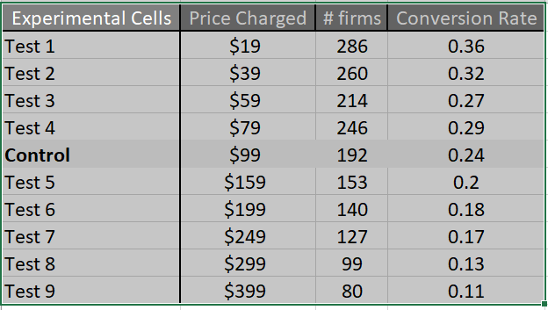
The Ziprecruiter Price Experiment Data
Based on the data, what price would you set?
Source: Dubé and Misra (2023)

Slide 21
The Ziprecruiter Price Experiment Data
Can AI handle the analytics?
Source: Dubé and Misra (2023)

Slide 22



The Ziprecruiter Price Experiment Ask ChatGPT- 4o for help…
Upload the data

Slide 23
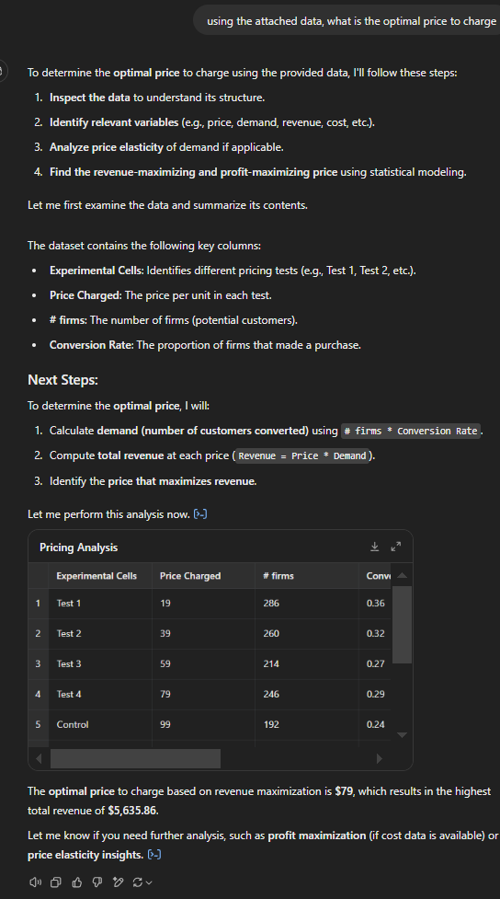


The Ziprecruiter Price Experiment Ask ChatGPT- 4o for help…
(my prompt)
VERY WRONG!
AI confused how to model demand
human can easily reason this
is incorrect but AI cannot reason!

Slide 24
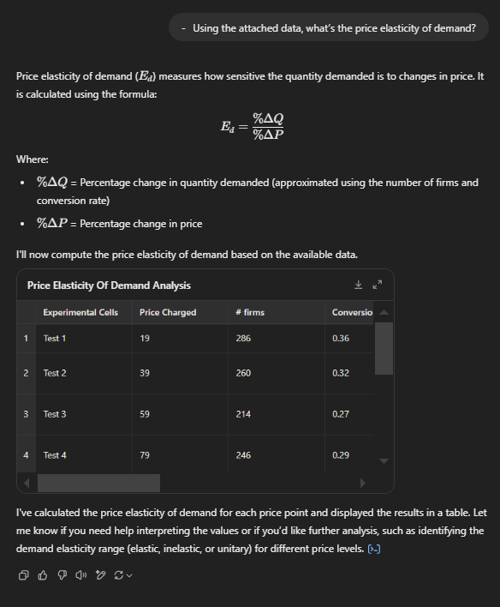

The Ziprecruiter Price Experiment Ask ChatGPT- 4o for help…
Click to see elasticity table

Slide 25
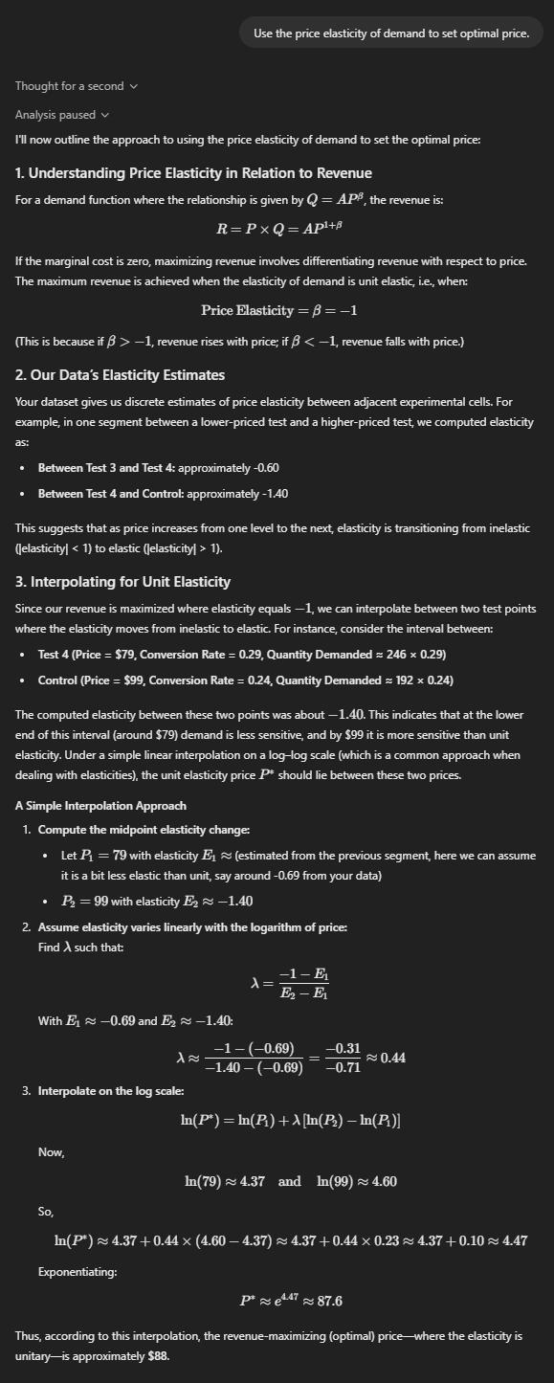


The Ziprecruiter Price Experiment Ask ChatGPT- 4o for help…
STILL WRONG!
AI confused how to model demand
Logic is right; but somehow AI messed up the elasticity analysis
Exercise:
Inverse-elasticity rule when marginal cost is $0?
➔ Price at unit-elastic point on demand!

Slide 26
The Ziprecruiter Price Experiment Ask ChatGPT- 4o for help…
Ok so we need to walk ChatGPT through the micro
1. help it figure out demand
2. set price using the “correct” demand
Also see appendix for detailed R code to analyze Ziprecruiter

Slide 27
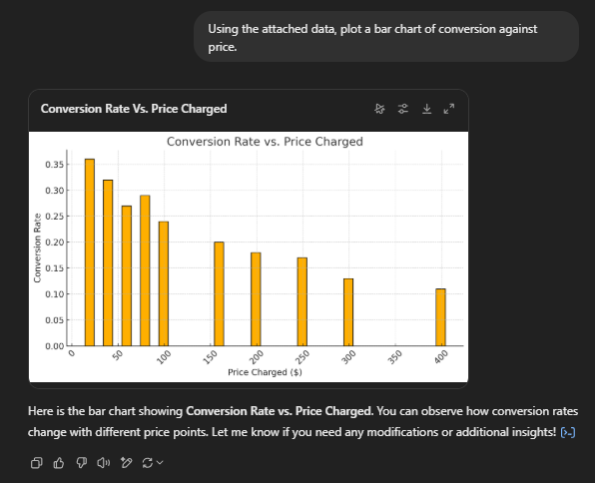

The Ziprecruiter Price Experiment Ask ChatGPT- 4o for help…
(my new prompt)
Do not lose much business even with 4-fold price increase!

Slide 28
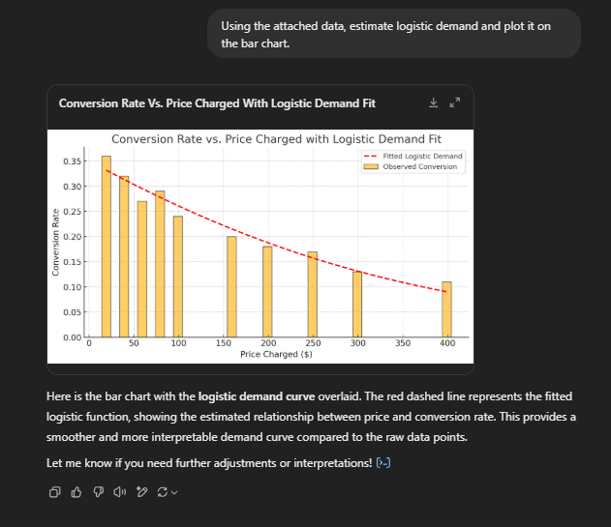

The Ziprecruiter Price Experiment Ask ChatGPT- 4o for help…
(my new prompt)

Slide 29
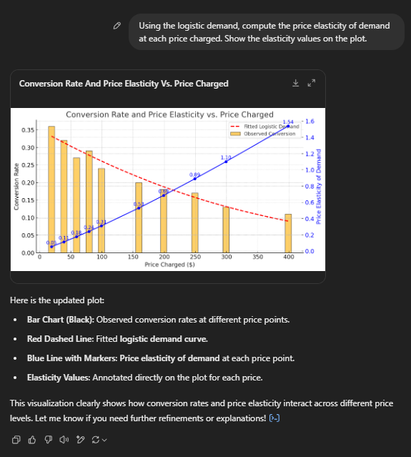

The Ziprecruiter Price Experiment Ask ChatGPT- 4o for help…
(my new prompt)
Using elasticity analysis from before, can again see unitary point is at much higher price

Slide 30
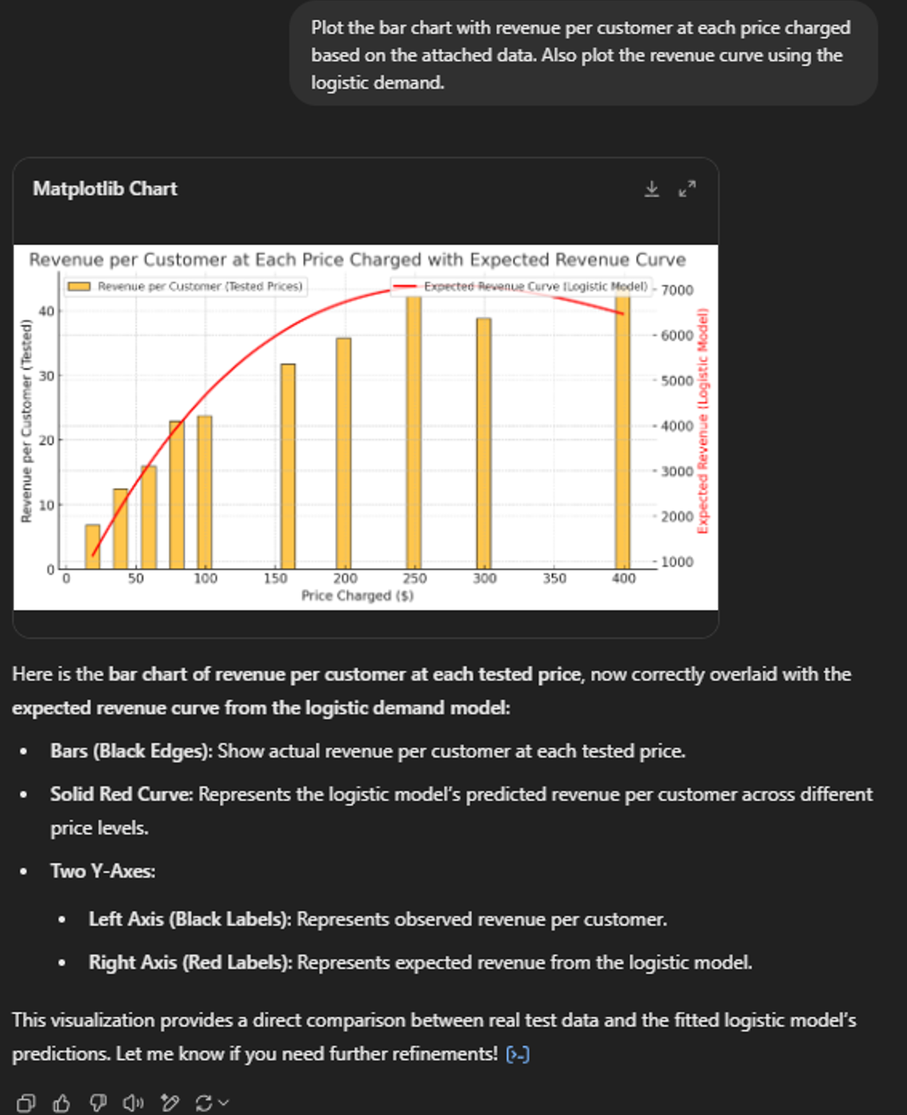

The Ziprecruiter Price Experiment Ask ChatGPT- 4o for help…
(my new prompt)

Slide 31
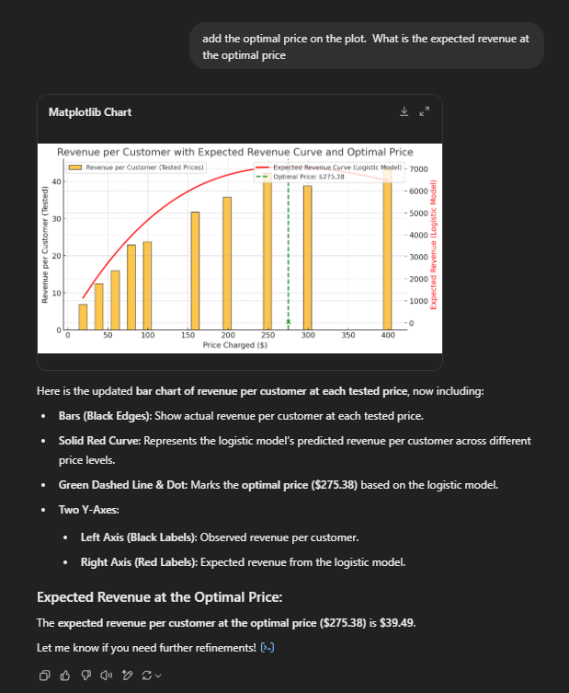


The Ziprecruiter Price Experiment Ask ChatGPT- 4o for help…
(my new prompt)
Wanna know how it found that price? See R code in Appendix for optimization

Slide 32
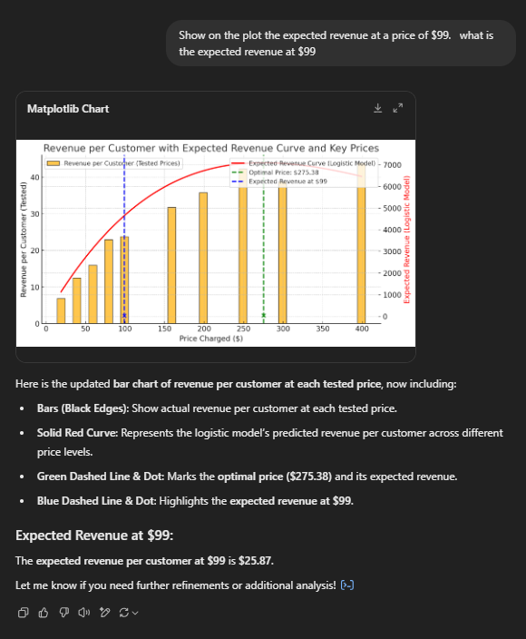

The Ziprecruiter Price Experiment Ask ChatGPT- 4o for help…

Slide 33
The Ziprecruiter Price Experiment Ziprecruiter’s implementation: only use test grid
N=7,867
Source: Dubé and Misra (2023)

Slide 34
The Ziprecruiter Price Experiment Ziprecruiter’s implementation: only use test grid
N=7,867
Optimal price on grid increases profits by over 60%!!!
Source: Dubé and Misra (2023)

Slide 35
The Ziprecruiter Price Experiment Ziprecruiter’s implementation: only use test grid
N=7,867
Zip ↑ price to $249 three days after experiment
GROWTH
Even with model & data, need to use judgment to implement a price
Source: Dubé and Misra (2023)

Slide 36


The Ziprecruiter Price Experiment Evaluation
Optimization increased monthly profits by 65%
Approximately $70 million in incremental profits over 5 years!

Slide 37
The Ziprecruiter Price Experiment Conclusions using ChatGPT- 4o as the Analyst
37
12
Oops …
under-pricing by over 60% (leaving a lot of money on the table)
Insight used basic prompt-based Generative AI
AI obviated need to write computer code!!!! (this is a BIG value add)
But
required simple experiment to get the right data
required trained manager to guide ChatGPT through the microeconomic modeling of demand

Slide 38
Take Away
Using the Price Elasticity of Demand for Pricing:
Typically want to price on elastic region of demand
Optimal pricing via inverse-elasticity rule
Elasticity measurement via randomized controlled A/B/C experiment
AI useful for avoiding computer coding , but requires expert (manager) guidance
See Appendix for detailed R code to analyze Ziprecruiter

Slide 39
Extra: Empirical Estimates of Price Elasticities

Slide 40
Interpretation & Generalizations How do you know if your estimate is right?
Presence of closer substitutes implies higher elasticity
Examples:
Insulin: canonical example of (totally?) inelastic demand
Wheat: canonical example of (perfectly) elastic demand

Slide 41
Marketing for Good: can price be too high? Even Insulin exhibits price elasticity!!!
Diabetes Patients at Risk From Rising Insulin Prices
A Yale study found that one in four patients admitted to cutting back on insulin use because of cost. The consequences can be deadly.
6-22-2018, New York Times
No generic versions
Between 2002 and 2013, price jumped from $40 to $130
Survey found many (especially those ineligible for Medicaid and unable to afford good insurance) report under-using insulin and rationing.

Slide 42
Interpretation & Generalizations How do you know if your estimate is right?
Average Elasticity for CPG (1,851 elasticities from 81 studies):
-2.62 (Hanssens 2015)
Small market share consumer brands often observed to be more price sensitive than large market share brands.
We also saw how pricing theory can provide a lower bound on plausible elasticities if prices are optimized

Slide 43

Elasticities and Margin Arithmetic

Slide 44
Margin Arithmetic
In practice, most firms do not know their demand.
Break-even analysis generates useful margin arithmetic as a surrogate
You can transform a uninformed debate about whether to implement a tactical price cut (e.g., -5%) and re-focus it on price-sensitivity of demand.
OK, you probably don’t know the elasticity, but…
The debate is now more focused
You might have a sensible gut instinct about price-sensitivity (e.g., you might know that your product is at least a bit differentiated)
Let’s take a look at the margin arithmetic …

Slide 45
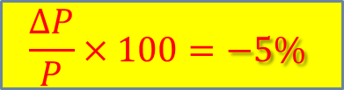
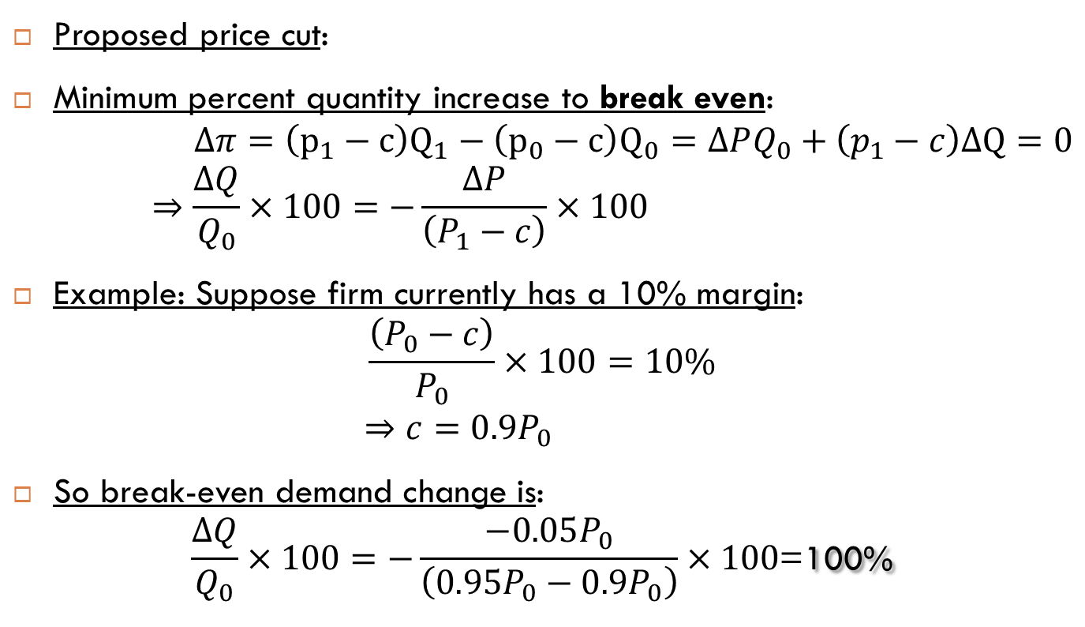
Price cutting and price elasticity
$$\frac{ΔP}{P}×100=−5\%$$
Proposed price cut:
Minimum percent quantity increase to break even:
$$Δπ=\left(p_{1}−c\right)Q_{1}−\left(p_{0}−c\right)Q_{0}=ΔPQ_{0}+\left(p_{1}−c\right)ΔQ=0$$
$$⇒\frac{ΔQ}{Q_{0}}×100=−\frac{ΔP}{\left(P_{1}−c\right)}×100$$
Example: Suppose firm currently has a 10% margin:
$$\frac{\left(P_{0}−c\right)}{P_{0}}×100=10\%$$
$$⇒c=0.9P_{0}$$
So break-even demand change is:
$$\frac{ΔQ}{Q_{0}}×100=−\frac{−0.05P_{0}}{\left(0.95P_{0}−0.9P_{0}\right)}×100\text{=}\text{100\%}$$

Slide 46

Price cutting and price elasticity
Many turn to price cutting as a means of stimulating sales. Does this practice stimulate Profits?
For low-margin products, it requires HUGE Elasticities!
Suppose we cut price by 5%, how much does volume have to increase to leave profits unchanged (i.e., to break even)?
$\frac{€2600−€53}{€2600}×100=98\%$ ➔ $β=−1.02$
Current Contribution Margin | Volume Increase Required | Price Elasticity Required
10% | 100% | -20
25% | 25% | -5
50% | 11% | -2.2
Notes:
Dprof = DP*Q0 + (p1-c)*DQ = 0
So DQ_BE/Q0 = -DP/(p1-c)
(p0-c)/p0 = .1 … so c = .9p0 … so DQ_BE/Q0 = .05*P0/(.95P0-.9P0) = 1

Slide 47
Ethical Margins?
Luxury Goods

Slide 48
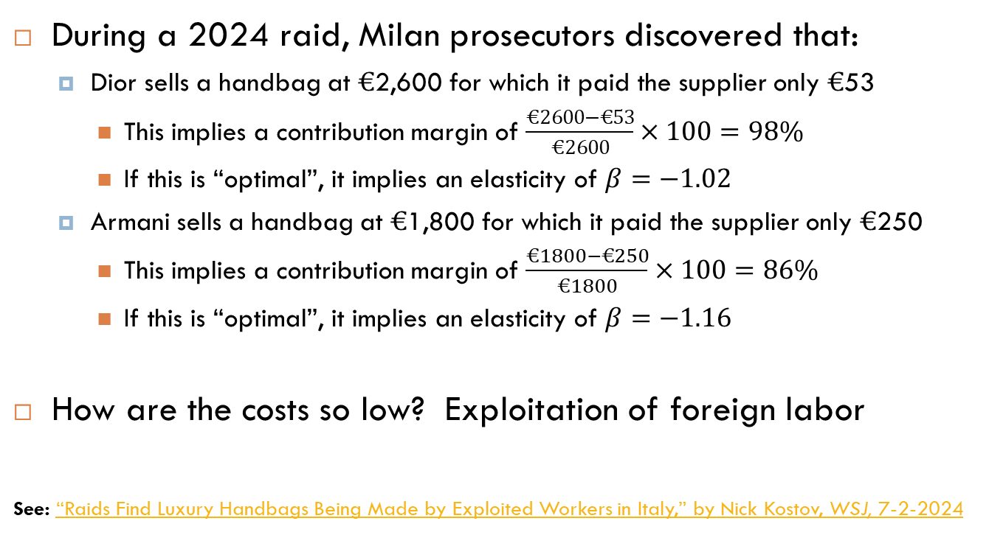
An inconvenient truth about high margins at Dior & Armani
During a 2024 raid, Milan prosecutors discovered that:
Dior sells a handbag at $€$2,600 for which it paid the supplier only $€$53
This implies a contribution margin of $\frac{€2600−€53}{€2600}×100=98\%$
If this is “optimal”, it implies an elasticity of $β=−1.02$
Armani sells a handbag at $€$1,800 for which it paid the supplier only $€$250
This implies a contribution margin of $\frac{€1800−€250}{€1800}×100=86\%$
If this is “optimal”, it implies an elasticity of $β=−1.16$
How are the costs so low? Exploitation of foreign labor
See: “Raids Find Luxury Handbags Being Made by Exploited Workers in Italy,” by Nick Kostov, WSJ, 7-2-2024

Slide 49
Ziprecruiter Data
Vector y has individual purchase decisions (0 or 1)
Vector p has the price charged to each individual
Data would look like the following:
Customer I.D. | Purchase (y) | Price (p)
1 | 1 | $99
2 | 0 | $99
3 | 0 | $139
4 | 0 | $259
5 | 1 | $99
6 | 0 | $79
7 | 1 | $79
… | … | …

Slide 50
A simulation in R to illustrate Code to create simulated choice data
N = 8000 # number respondents
betatrue = matrix(c(-0.64,-0.004)) # inter. & price coeff
testprices=matrix(c(19,39,59,79,99,159,199,249,299,399))
Price = sample(testprices,size=N,replace=T) # randomize prices
epsilon = -log(-log(runif(N))) +log(-log(runif(N))) # draw logistic errors
U = betatrue[1]+betatrue[2]*Price+epsilon # buying utility
Y = (U>0)*1 # choice data

Slide 51
Estimate the logistic regression in R
If you have the vectors Y and P in memory, you can estimate the logistic demand using the “glm” function in R
Estimate the logit demand using built-in glm function in R:
out = glm(Y~P,family=“binomial”)
Extract the demand coefficient estimates
betahat = out$coefficients

Slide 52
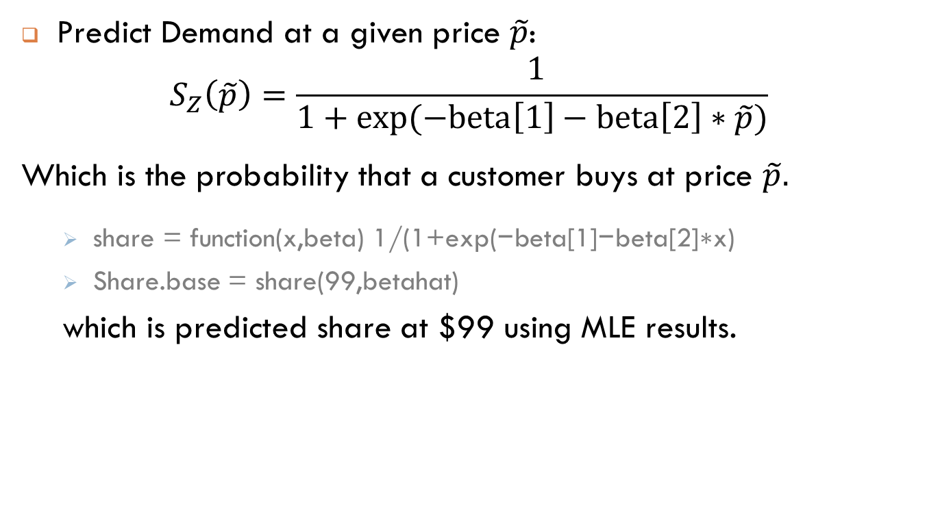
Predict Level of Logistic Demand in R
Predict Demand at a given price $\tilde{p}$:
$$S_{Z}\left(\tilde{p}\right)=\frac{ 1}{1+exp⁡(−beta\left[1\right]−beta\left[2\right]∗\tilde{p})}$$
Which is the probability that a customer buys at price $\tilde{p}.$
$\text{share}\text{ = }\text{function}\text{(}\text{x}\text{,}\text{beta}\text{) 1/(1+}\text{exp}\text{(−}\text{beta}\text{[1]−}\text{beta}\text{[2]∗}\text{x}\text{)}$
Share.base = share(99,betahat)
which is predicted share at $99 using MLE results.

Slide 53
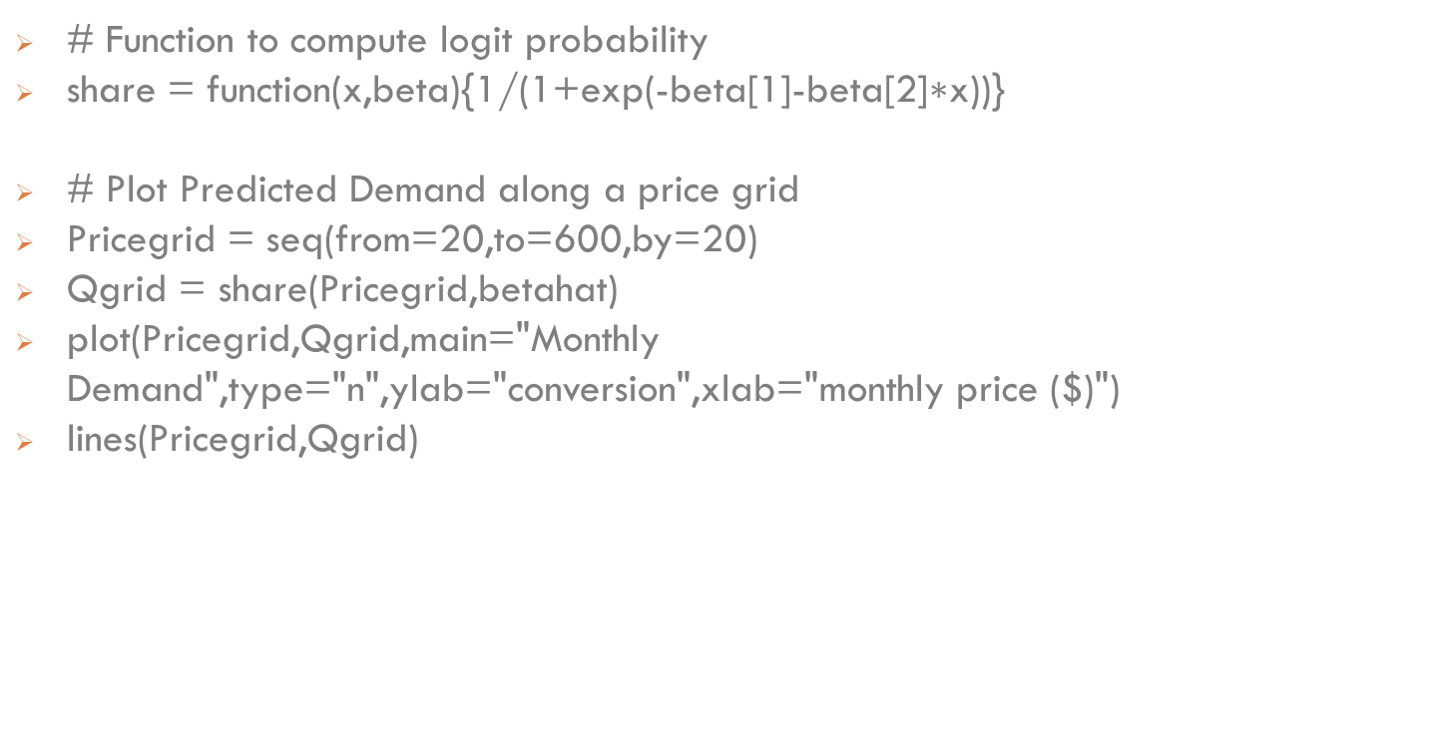
Now we can plot demand
# Function to compute logit probability
share = function(x,beta){1/(1+exp(-beta[1]-beta[2]$\text{∗}\text{x}$))}
# Plot Predicted Demand along a price grid
Pricegrid = seq(from=20,to=600,by=20)
Qgrid = share(Pricegrid,betahat)
plot(Pricegrid,Qgrid,main="Monthly Demand",type="n",ylab="conversion",xlab="monthly price ($)")
lines(Pricegrid,Qgrid)

Slide 54
A simulation in R to illustrate Plot demand estimates

Slide 55
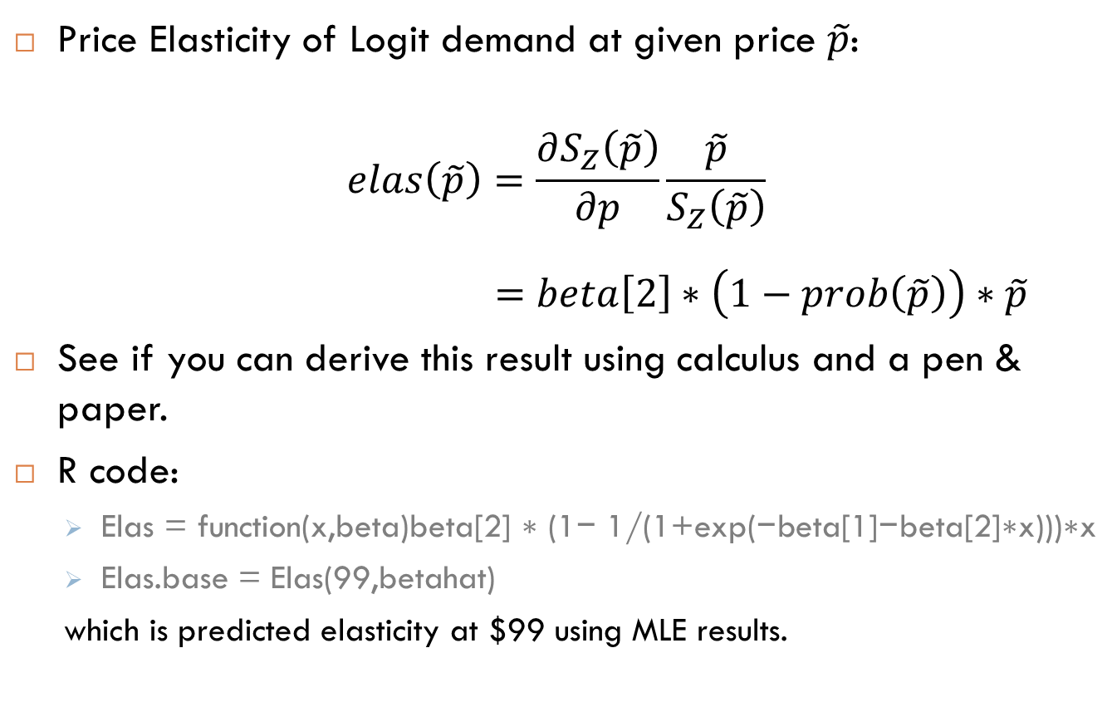
Compute the Price elasticity of demand
Price Elasticity of Logit demand at given price $\tilde{p}$:
$$elas\left(\tilde{p}\right)=\frac{∂S_{Z}\left(\tilde{p}\right)}{∂p}\frac{\tilde{p}}{S_{Z}\left(\tilde{p}\right)}$$
$$=beta\left[2\right]∗\left(1−prob\left(\tilde{p}\right)\right)∗\tilde{p}$$
See if you can derive this result using calculus and a pen & paper.
R code:
$\text{Elas}\text{ = }\text{function}\text{(}\text{x}\text{,}\text{beta}\text{)}\text{beta}\text{[2] ∗ (1− 1/(1+}\text{exp}\text{(−}\text{beta}\text{[1]−}\text{beta}\text{[2]∗}\text{x}\text{)))∗}\text{x}$
Elas.base = Elas(99,betahat)
which is predicted elasticity at $99 using MLE results.

Slide 56
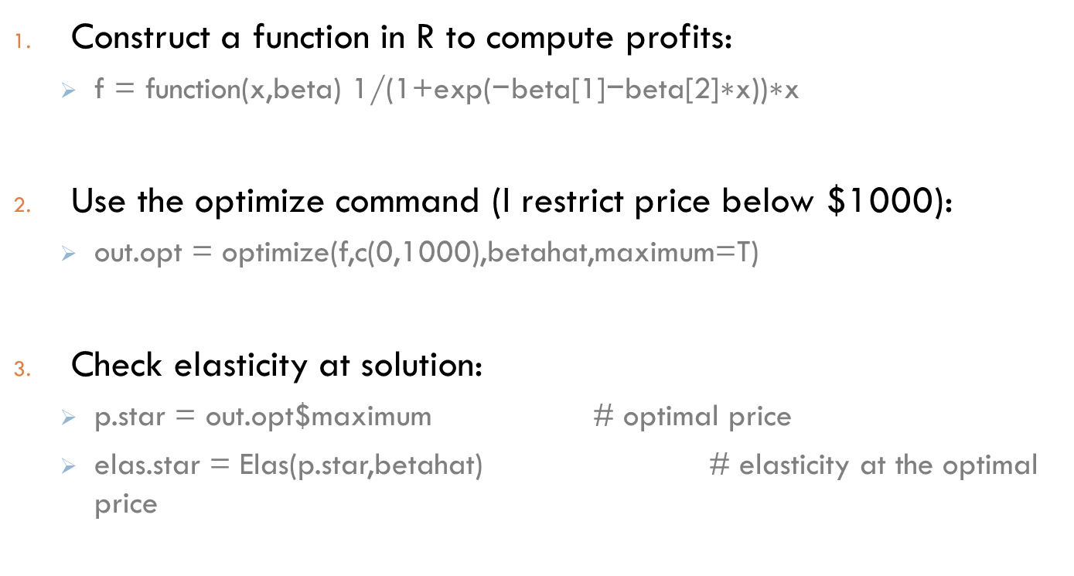
Compute the Profit-Maximizing Price
Construct a function in R to compute profits:
$\text{f}\text{ = }\text{function}\text{(}\text{x}\text{,}\text{beta}\text{) 1/(1+}\text{exp}\text{(−}\text{beta}\text{[1]−}\text{beta}\text{[2]∗}\text{x}\text{))∗}\text{x}$
Use the optimize command (I restrict price below $1000):
out.opt = optimize(f,c(0,1000),betahat,maximum=T)
Check elasticity at solution:
p.star = out.opt$maximum # optimal price
elas.star = Elas(p.star,betahat) # elasticity at the optimal price

Slide 57
Compute the Profit-Maximizing Price You can also use the inverse-elasticity rule!
Function to measure difference in elasticity and “-1”:
ElasRule = function(x,beta) {
beta[2] * (1- 1/(1+exp(−beta[1]−beta[2]∗x)))∗x+1
}
Load the solver function in R “nleqslv”
install.packages("nleqslv") # install package
Library(nleqslv) # load library
now use solver to find optimal price (easy to do in Excel too):
out = nleqslv(x=0,fn=ElasRule,beta=betahat)
Extract optimal price:
p.star1 = out$x

